Slide 1


The Importance of Biogeography in Determining Species Response to Climate Change
Caitlin A. Chapman, Neil S. Cobb 2015
Merriam-Powell Center for Environmental Research and Department of Biological Sciences, Northern Arizona University, Flagstaff, AZ 86011

Slide 2
Questions
What is the importance of biogeography in determining species response to climate change?
Will species currently distributed similarly respond similarly to predicted patterns of climate change?

Slide 3
How?
BIOMOD2 – R software package
Real occurrence data (lat, lon) -> predicted occurrence data
  Environmental variables for each data point: temperature and precip -> suitable climate envelopes -> geospatial context
Predicted habitat projected onto GCMs and emissions scenarios
  =future suitable habitat (2080s decade)
  Both for Colorado Plateau and Western North America

Slide 4


Data
Genus Pardosa within family Lycosidae (wolf spiders)
Symbiota Collections of Arthropods Network (SCAN)
Global Biodiversity Information Facility (GBIF)
6 taxa restricted to three regional areas – Colorado Plateau, Rocky Mountains, general Southwest
  CP – Pardosa utahensis, Pardosa yavapa
  RM – Pardosa Coloradensis, Pardosa groenlandica
  SW – Pardosa orophila, Pardosa sierra

Slide 5
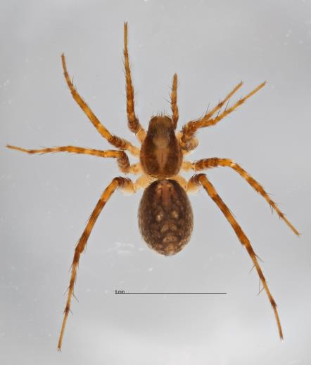
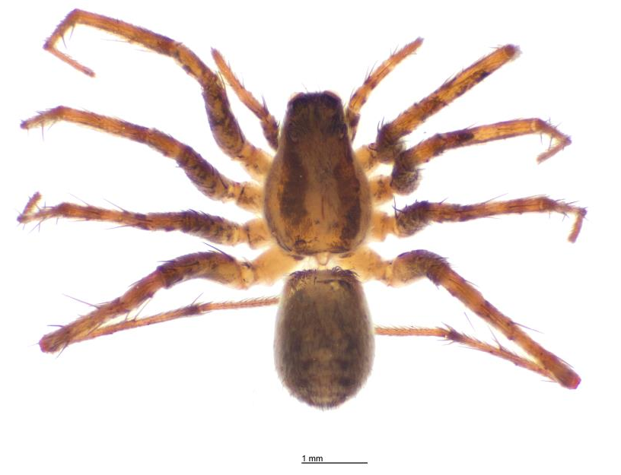
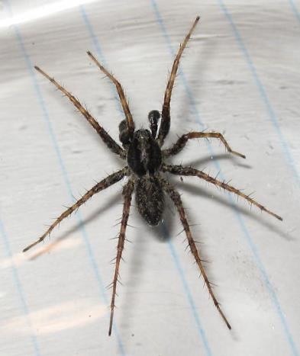
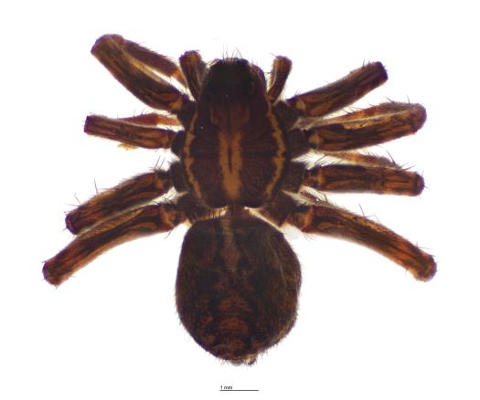
Who are these critters anyway?
Pardosa orophila
Pardosa yavapa
Pardosa groenlandica
Pardosa coloradensis

Slide 6
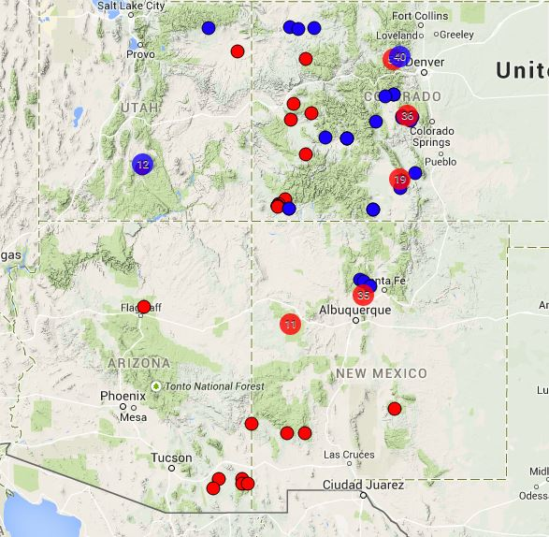
Colorado Plateau Species Guild – Current Distribution Data
Blue = P. utahensis
Red = P. yavapa
Average elevation of occurrences: 2418m

Slide 7
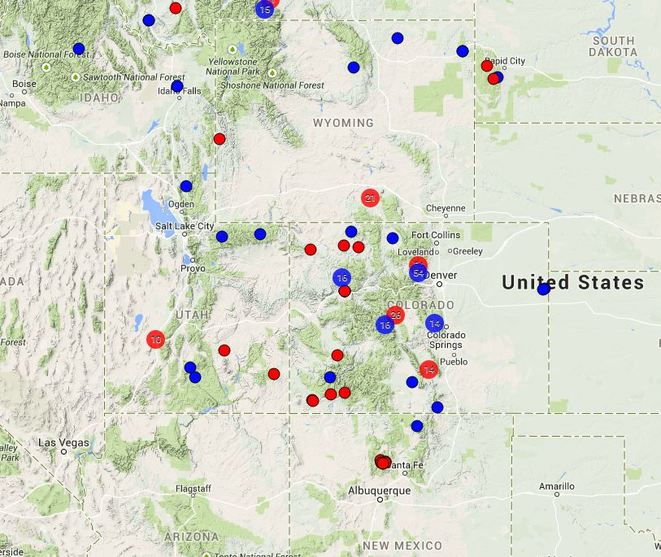
Rocky Mountain Species Guild – Current Distribution Data
Blue = P. groenlandica
Red = P. coloradensis
Average elevation of occurrences: 2446m

Slide 8
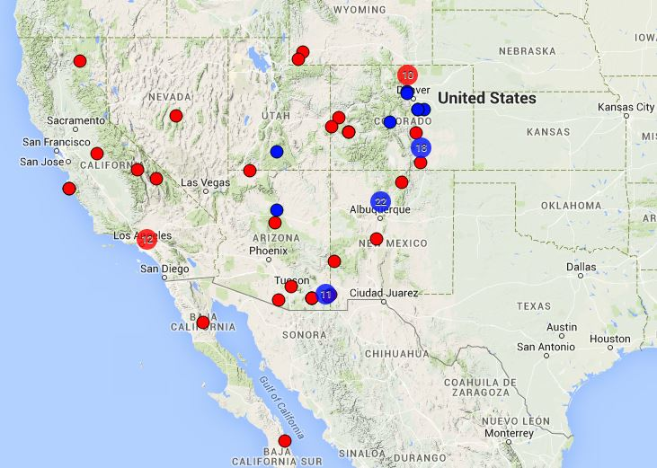
Southwestern Species Guild – Current Distribution Data
Blue = P. orophila
Red = P. sierra
Average elevation of occurrences: 1408m

Slide 9
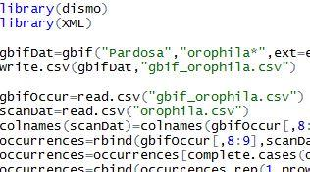
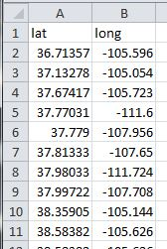
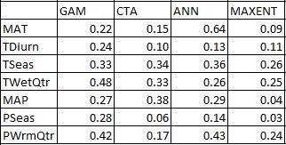
Actual Data
Examine environmental variables
Predicted data!
BIOMOD2

Slide 10
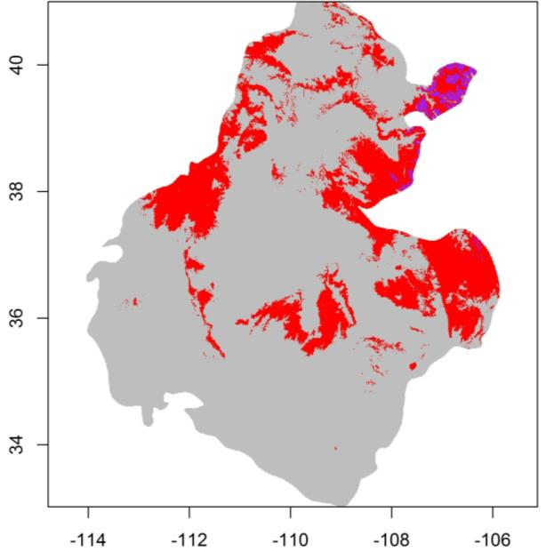
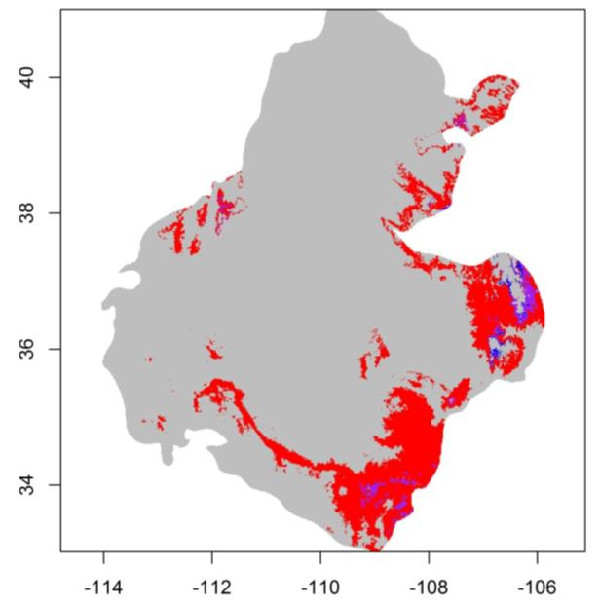
Results
RED = HABITAT LOSS
PURPLE = HABITAT RETENTION
BLUE = HABITAT GAIN
Colorado Plateau Species
P. utahensis
P. yavapa
97% Habitat loss
3% Retention
0% Gain
94% Habitat loss
5.5% Retention
.5% Gain
91% Habitat loss
8% Retention
1% Gain
AVG:

Slide 11
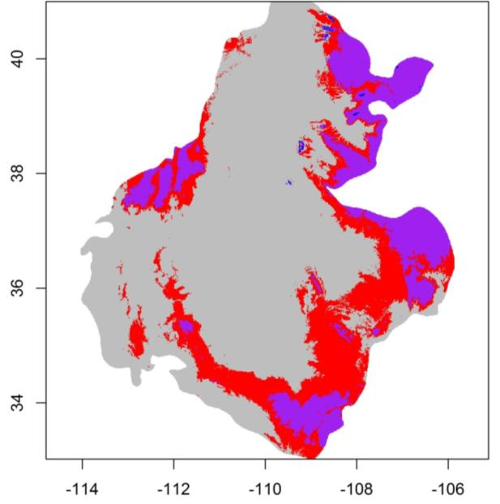
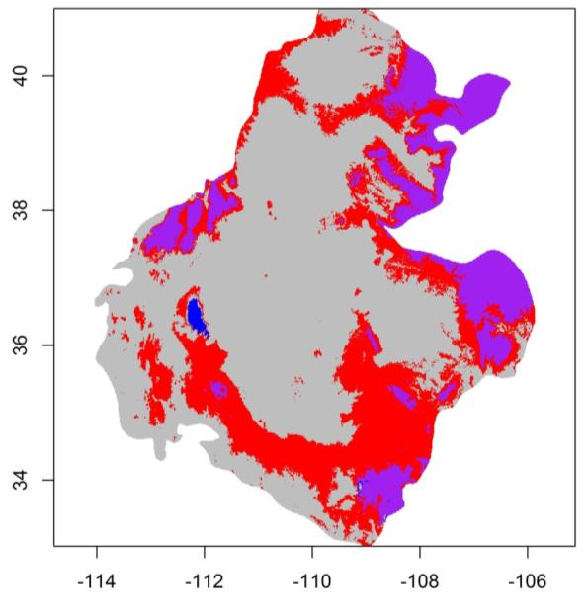
Results
RED = HABITAT LOSS
PURPLE = HABITAT RETENTION
BLUE = HABITAT GAIN
Rocky Mountain Species
P. coloradensis
P. groenlandica
52% Habitat loss
47% Retention
0.24% Gain
57% Habitat loss
42% Retention
.62% Gain
62% Habitat loss
37% Retention
1% Gain
AVG:

Slide 12
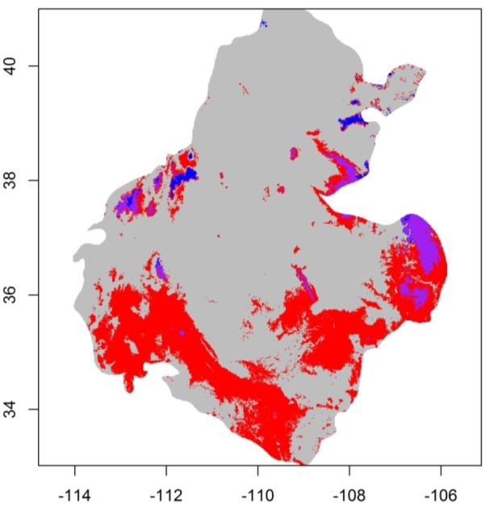
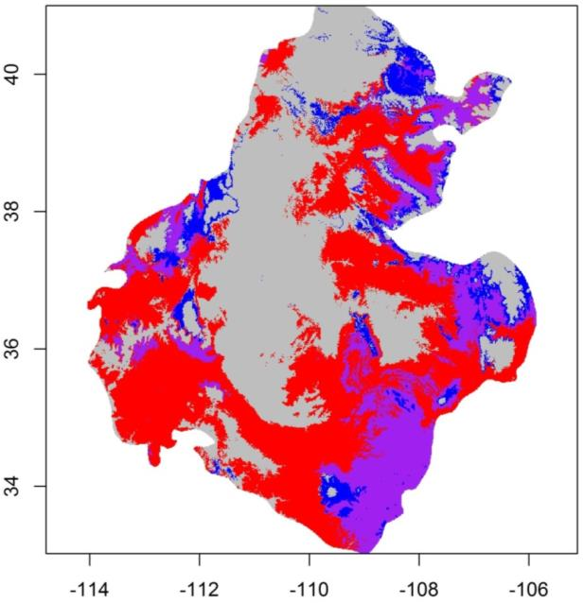
Results
RED = HABITAT LOSS
PURPLE = HABITAT RETENTION
BLUE = HABITAT GAIN
Southwest Species
P. orophila
P. sierra
86% Habitat loss
11% Retention
3% Gain
76% Habitat loss
15% Retention
9% Gain
66% Habitat loss
19% Retention
15% Gain
AVG:

Slide 13
What does this mean?
Similarly distributed species respond… similarly
  Current distribution can predict future distribution?
Spiders may be at great risk of habitat loss/degradation due to climate change
  What else could be?

Slide 14
Any questions?
Acknowledgements:
  NASA Space Grant
  Neil Cobb
  Lindsie McCabe
  Dr. Sandra Brantley of UNM

